Slide 1
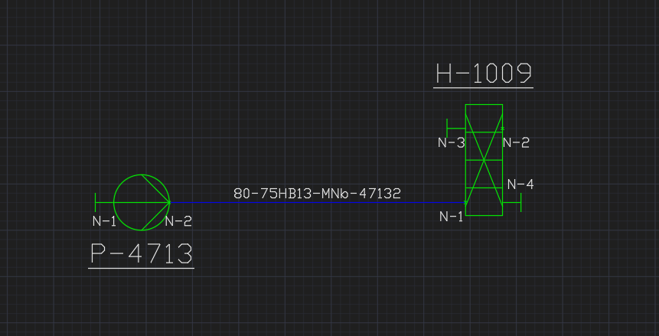
E06V01 Pump, HeatExchanger, Nozzles Connected With PNS

